Slide 1
Bridgestone NZ Ltd: Electronic job card
Initial Presentation
Presented by Scott Patterson

Slide 2
Presentation Agenda
Item 1
The Project
Item 2
The Company
Item 3
The Problem and Solution
Item 4
What This Means For Me

Slide 3
The Project Given
“A mobile application needs to be developed for their electronic job card.
This is to emulate the manual recording of information on a job card to a Mobile device with a view linking ultimately to the Advanced Retail POS system.”
Project supervisors: Candy He, Philip Low

Slide 4
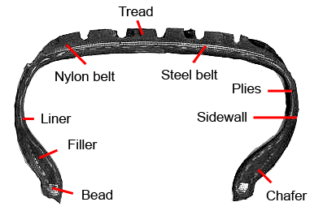
About the Company
- Renowned Tire and Rubber Manufacturer
- Created by Shojiro Ishibashi in 1931
- Purchased Firestone Tire and Rubber Company in 1988
- Bridgestone New Zealand Limited formed in 1998

Slide 5
The Problem and Proposed Solution
Currently:
- Bridgestone fleet technician will go off site with papers and record information about the client and their vehicle
- Paper is given to a second employee to be keyed into the Point of Sales system to produce an invoice (highly redundant)
Ideally:
- Bridgestone fleet technician will go off site with a device and record only new information, with all client and vehicle information that has been previously recorded, date and location auto populated
- Data is sent to database and an invoice is produced, no need to enter information twice

Slide 6
What I Am Doing
What I Have Done:
Thorough walkthrough of systems
Refining the scope and constraints
Creating a use case diagram
Learning web services (WCF) and creating a simple SQL database query service with interface
Attended Windows camp
What Next?
Demonstrate use of software for diagrams and interfaces
Documentation and Research (Problem and Opportunity, Feasibility Analysis, Costs)
Meeting the users
Produce prototypes and get feedback

Slide 7
What I Can Gain
Work Experience
Working in a business environment, with supervisors and responsibilities
Seeing the business processes I have learnt in courses in action
Skills with hardware, software, languages and planning
Gain business contacts

Slide 8
Questions?
Thank You

